Slide 1
PCA (patient controlled analgesia) ADULT
NSW Pain Form
June 2023
Emily Edmonds | Co-ordinator NSW Pain Forms, CNC Acute Pain Service Blacktown Hospital

Slide 4
PCA (patient controlled analgesia) form - adult
The PCA prescription and observation form for adult patients has been developed in NSW by a team of experts in the field of acute pain including clinical nurse consultants, anaesthetists and pharmacy representatives.
This PCA form is not suitable for use in paediatric patients.
Standardisation of this chart promotes best practice in prescribing, pain assessment and management of adverse effects in those patients receiving an opioid via PCA.

Slide 5
Aim of this presentation
This presentation aims to explain:
how to use the form for prescribing a PCA
how to record the administration and discard of drugs used for PCA
how to complete the clinical observations
guidelines on the management of patients receiving PCA including the management of adverse effects.

Slide 6
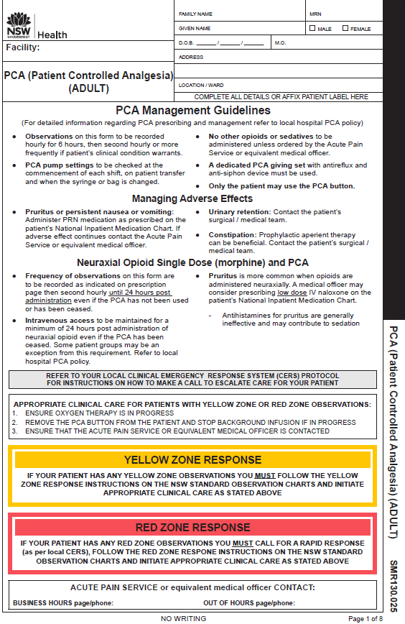
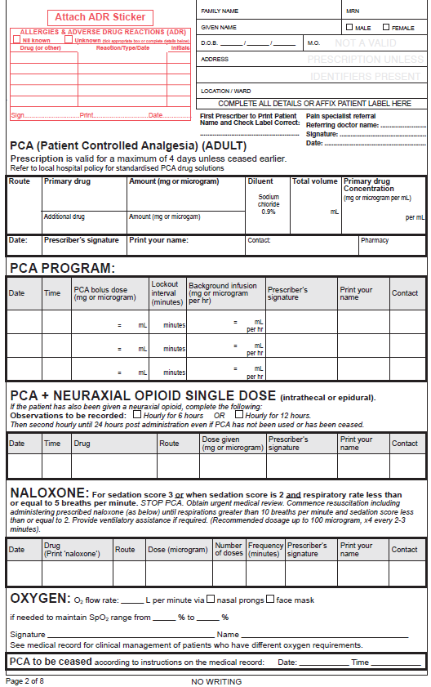
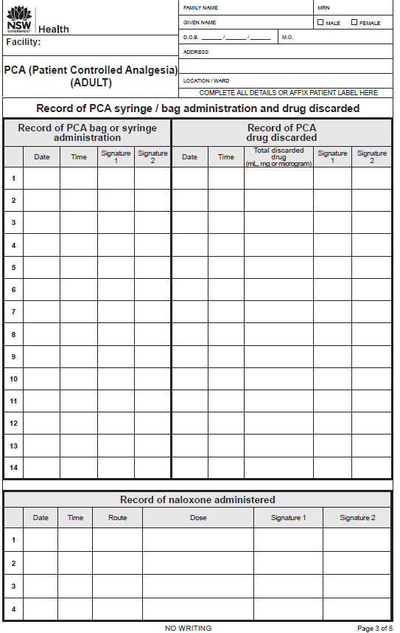
Booklet format
Prescription valid for 4 days | Observation pages for 4 days
PCA form adult
Page 1
Page 2
Page 3
Page 1 Management guidelines Yellow and Red Zone response instructions
Page 2 PCA prescription, PCA program, Neuraxial opioid and PCA, Naloxone and oxygen prescription, Cease PCA
Page 3 PCA drug administration, Drug discard, Naloxone administration

Slide 7
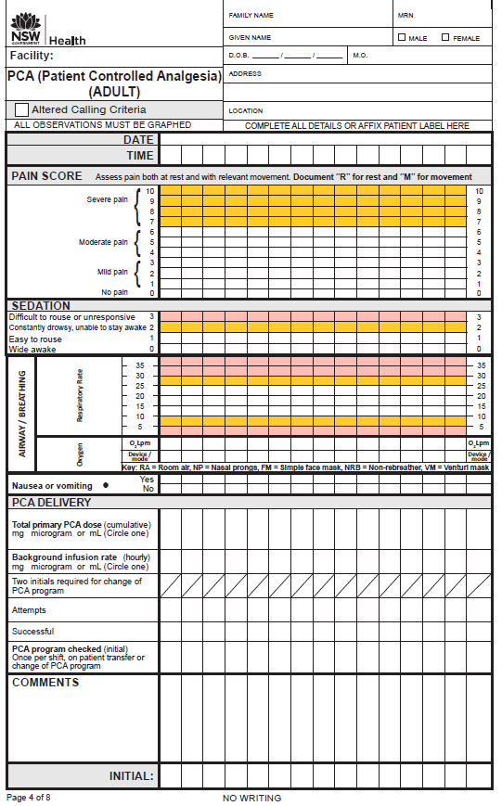
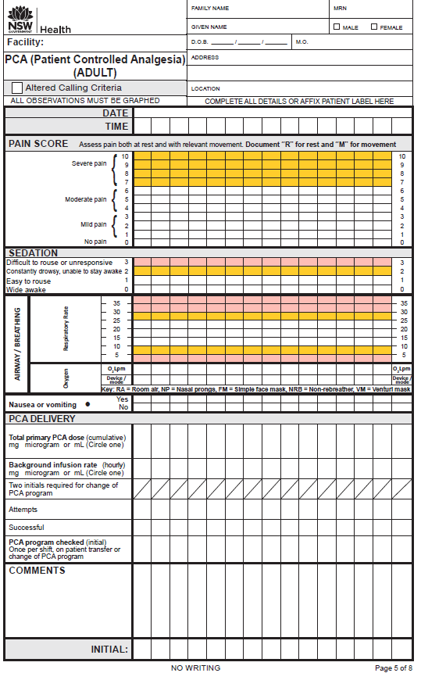
PCA form adult: observation pages for up to 4 days

Slide 8
PCA form adult: PCA Management Guidelines
For detailed information regarding PCA prescribing and management refer to local hospital PCA policy or procedure
Instructions for managing patients whose observations are in the Yellow or Red Zone
Space provided for the contact details of your Acute Pain Service or equivalent medical officer who manages PCA

Slide 9
Patient label and allergy adverse reactions
PCA form adult: prescription page 2
Patient label and allergy adverse reactions
PCA prescription
Page 2
PCA program allows for two further changes to the program
Record of administration of a neuraxial opioid
Record of administration of a neuraxial opioid
Prescription for oxygen cease instruction

Slide 10
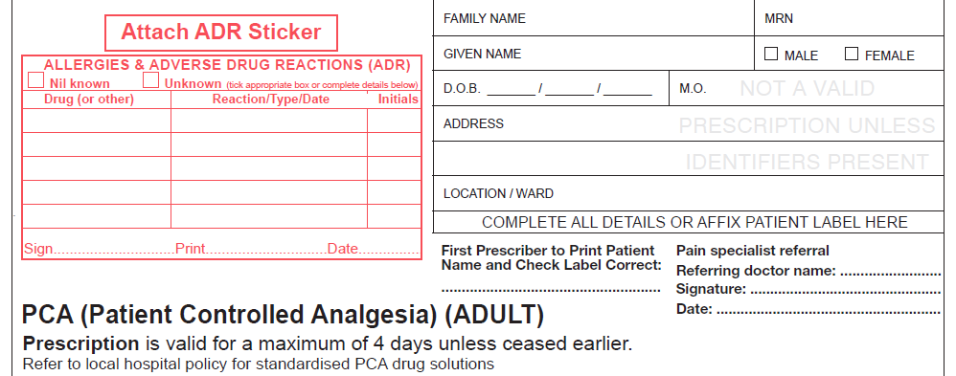
Below is an EXAMPLE program.
Refer to hospital PCA policy for local guidelines on PCA prescribing.
PCA prescription
Handwrite patient details OR affix patient label
(First prescriber to check patient label is correct)
Prescriber to complete patient allergy and ADR section in full
PRIVATE PATIENTS:
For Medicare billing purposes pain specialist referral from the referring doctor (name), signature and date
TSmith SMITH 5/4/17

Slide 11
Below is an EXAMPLE program.
Refer to hospital PCA policy for local guidelines on PCA prescribing.
PCA prescription
PCA prescription to include: route, primary drug (e.g. morphine or fentanyl) total amount in mg or microgram, total volume and primary drug concentration
A PCA prescription is for one opioid only. When changing from one opioid to another, a new PCA chart must be commenced.
IV
Morphine 60mg
NIL
60 mL
1 mg/mL
4/4/17 Smith SMITH Page 7511
Prescriber’s signature, printed name and contact
Space is provided for an additional drug to be added if needed
Space provided for pharmacist reconciliation

Slide 12
Below is an EXAMPLE program.
Refer to hospital PCA policy for local guidelines on PCA prescribing.
PCA program
PCA bolus dose (state unit of drug and volume)
Lockout interval in minutes
Background infusion (State mg or microgram and mL per hour)
4/4/17 10:00 1mg 1 5 nil TSmith SMITH 7511
5/4/17 09:00 1.5mg 1.5 5 1mg 1 S.Jack JACK 3852
Two additional rows are provided for changes to the PCA program
When changing from one opioid to another, a new PCA chart must be commenced
Prescriber’s signature, print name and contact

Slide 13
Below is an EXAMPLE program.
Refer to hospital PCA policy for local guidelines on PCA prescribing.
Neuraxial opioid + PCA
The frequency of observations
(hourly for 6 hours or hourly for 12 hours) must be determined by the medical officer who administered the morphine dose
IF a dose of morphine has been administered via the spinal or epidural route during a procedure, AND the patient is to receive a PCA, the following is to be completed

4/4/17 10:00 Morphine Spinal 200 TSmith SMITH 7511
microgram

Slide 14
Below is an EXAMPLE program.
Refer to hospital PCA policy for local guidelines on PCA prescribing.
Naloxone prescription
Naloxone is indicated for:
SEDATION SCORE 3 (difficult to rouse or unresponsive) OR
SEDATION SCORE 2 (constantly drowsy unable to stay awake) and a
RESPIRATORY RATE LESS THAN OR EQUAL TO 5 breaths per minute.
4/4/17 Naloxone IV 100 x4 2-3 TSmith SMITH 7511
microgram minutely
Naloxone may be prescribed electronically in some facilities.
A standing order for naloxone may exist in some facilities.
Refer to local PCA policy or procedure.

Slide 15
Below is an EXAMPLE program.
Refer to hospital PCA policy for local guidelines on PCA prescribing.
Oxygen order and PCA CEASE statement
Oxygen prescription flow rate via nasal prongs or face mask and Sp02 range
2

92 96
PSmith SMITH
PCA can be ceased according to instructions in the medical record:
date and time prompt provided
(Check local policy for use of this prompt)

Slide 16
Administration and discard of PCA opioid and administration of naloxone
Discard of any remaining PCA opioid or drug
Page 3
PCA commenced
Naloxone that may have been administered

Slide 17
Administration and discard of PCA drug
4/4/17
10:00
THall
SRose
4/4/17
20:00
NIL
BLoh
JLucas
4/4/17
20:00
BLoh
JLucas
5/4/17
09:00
15 mL
Plambert
TBuckley
Any opioid or drug remaining from a syringe or bag to be recorded on the corresponding row from its administration.
IF a PCA syringe or bag is empty when the next one is commenced, document ‘NIL’ discarded.
There are 14 rows provided to record PCA administration and discard.

Slide 18
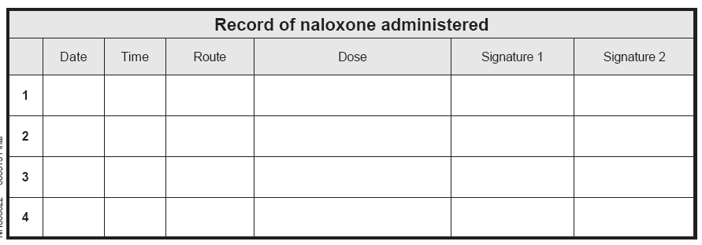
Record of naloxone administered
Naloxone may only be administered when the prescription section of the PCA chart has been completed in full OR if a naloxone standing order is in available
04/4/17
08:30
IV
100 microgram
PLambert
TBuckley
04/4/17
08:33
IV
100 microgram
PLambert
TBuckley
04/4/17
08:36
IV
100 microgram
PLambert
TBuckley
04/4/17
08:39
IV
100 microgram
PLambert
TBuckley
Naloxone may be prescribed electronically in some facilities. Refer to local PCA policy or procedure.

Slide 19
Observations
The PCA chart provides observations for a maximum of 4 days.
If the PCA continues beyond 4 days, a new PCA chart must be started and a new prescription written.
Observation pages

Slide 20
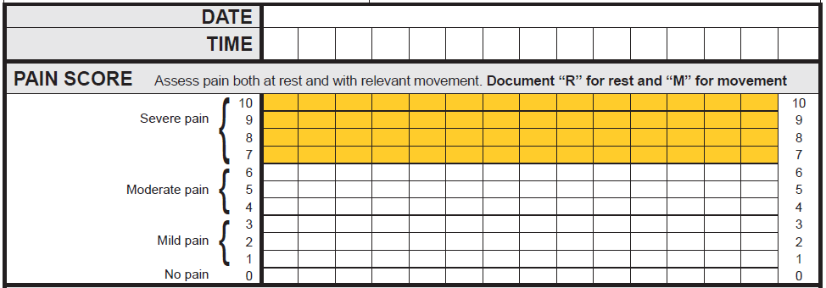
Documenting observations: Pain Assessment ‘R’ for rest ‘M’ for movement
Where a patient scores their pain 7 or above (in the Yellow Zone), the nurse must assess the current clinical pain management plan for the patient.
For example:
Have pain scores previously been in the White Zone (0 to 6)?
Does the patient understand how to use the PCA?
Have additional prescribed analgesics been administered?
Has the patient been reviewed by the Acute Pain Service or equivalent medical officer?
The assessing nurse may need to consult with the NURSE IN CHARGE to decide whether a CLINICAL REVIEW (or other CERS – Clinical Emergency Response) call should be made.
05/10/14
1100
1200
1300
1400
1500
M
M
M
M
M
R
R
R
R
R

Slide 21
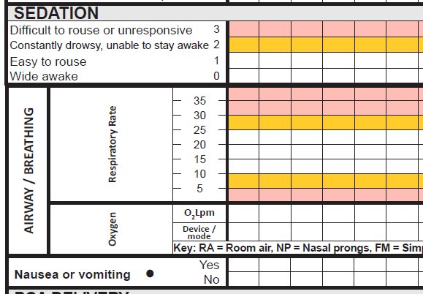
Documenting observations: sedation, respiratory rate, oxygen therapy, nausea and vomiting
A sedation score or a respiratory rate in the ‘Yellow Zone’ require a Clinical Review by the Acute Pain Service (or equivalent medical officer)










A sedation score or a respiratory rate in the ‘Red Zone’ require a Rapid Response to be initiated
AND
contact the Acute Pain Service (or equivalent medical officer)
2L 2L 2L 6L
NP NP NP FM





Assessments to be recorded graphically as indicated

Slide 22
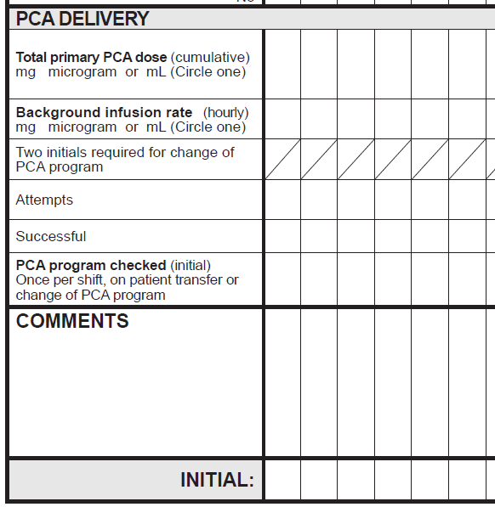
Documenting observations: PCA delivery
Total primary PCA dose (cumulative)
Circle the unit that is being used
2
mg
10
mg
13
mg
20
mg
25
mg
NIL
–
–
–
1
mg
Background infusion rate (if in use)
TJ
JS
Two initials are required for change of PCA program
2
13
16
25
30
2
10
13
20
25
Total demands/successful demands (different pumps use different words to describe how many times the button is pressed)
JS
–
–
–
TJ
Comments section blank for free text and
assessors initial
PCA program checked: once per shift on patient transfer or change of PCA program - to ensure the pump program matches the prescription
Ondanestron given
TJ
JS JS JS JS JS

Slide 23
The next two slides details:
the front page PCA Management Guidelines
clinical care for patients with Yellow or Red Zone observations

Slide 24
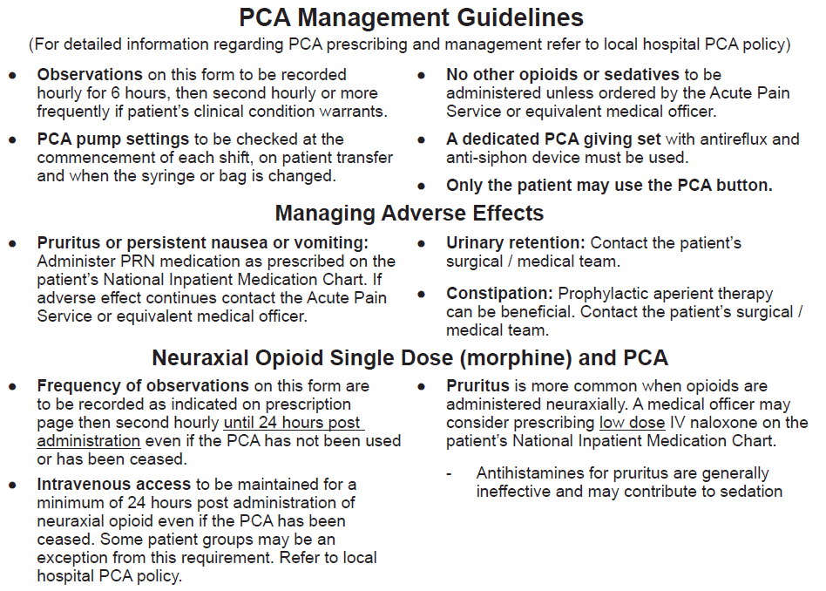

Slide 25
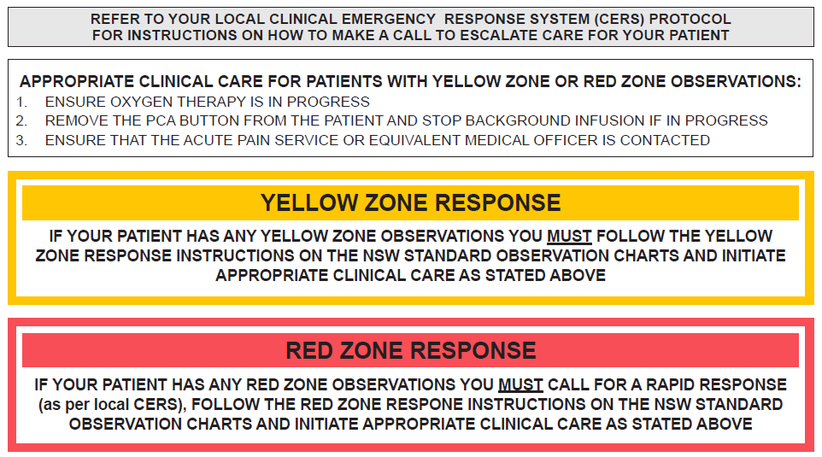

Slide 26
The standardisation of this form promotes best practice in prescribing, pain assessment and management of adverse effects in those patients receiving an opioid via PCA.
Information related to the NSW Pain Forms can be found on the ACI website:
http://www.aci.health.nsw.gov.au/networks/pain-management/acute-pain-forms
Comments or questions can be forwarded to:
Susan Rogers
Manager Pain Management Network
Agency for Clinical Innovation (ACI)
Phone: 0436611400
Email: ACI-PainManagement@health.nsw.gov.au
Emily Edmonds
Pain Nurses Australia: Director Corporate Governance
CNC Acute Pain Service Blacktown Hospital
Phone: 0427074007
Email: emily.edmonds@health.nsw.gov.au
OR

Slide 27
This presentation was first prepared in 2013-2014 and reviewed in 2017 by the former NSW Pain Interest Group Nursing Issues in association with the ACI Pain Management Network.
A review was undertaken in 2023 by NSW members of Pain Nurses Australia.

Slide 28
Published Jun 2023. Next review 2028. SHPN: (ACI) 230323 ISBN: 978-1-76023-525-3
ACI/D23/814 [ACI_8121] © State of NSW (Agency for Clinical Innovation) CC-ND-BY​

